Slide 1
State Programs’ Familiarization
Fargo Cass Public Health

Slide 2
State Programs
Health Alert Network (HAN) Assets
Everbridge
Health Care (HC) Standard

Slide 3
Health Alert Network (HAN) Assets
HAN Assets can be found at hanassets.nd.gov
It is the site for all the medical cache located in Bismarck.
Consumable goods must be replaced to the cache, unless it is during a declared emergency.
If you set up a new account, you can ignore membership.

Slide 5
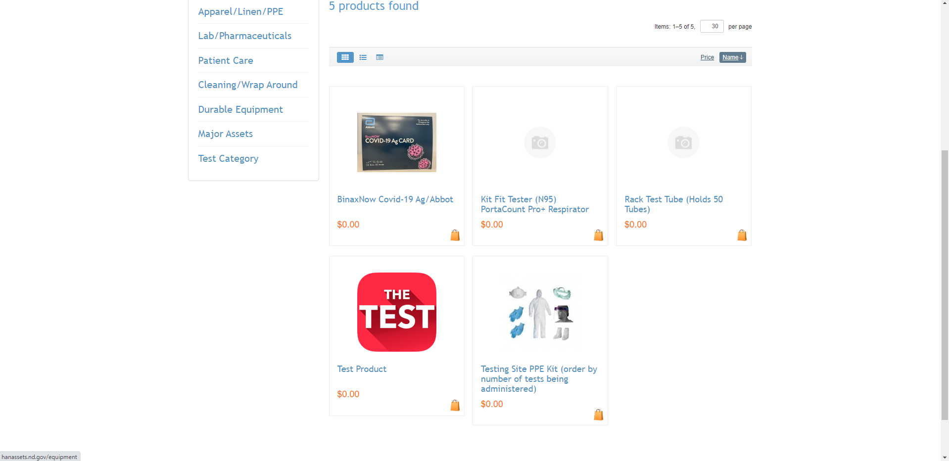

Slide 9
Everbridge
Everbridge is an emergency mass notification system paid for and managed by NDDOH Emergency Preparedness and Response Division.
This is a FREE mass notification system for your facility’s use.

Slide 10
Everbridge is 2 Parts
1. Uploading/Updating a Contact List
2. Requesting a Message

Slide 11
Uploading/Updating a Contact List
Everbridge works in lists
Staff List
Resident List
Next of Kin list

Slide 12
Uploading/Updating a Contact List
Lists can be updated daily, weekly, monthly, yearly. Your list is ONLY as current as the last time you updated it.
Example: If you haven’t uploaded an NOK list in a year and have experienced even one death in your facility since the update, you are running the risk of sending messages out to someone who has experienced that loss. These messages are constant reminders that their loved one is no longer here. Preventing this is KEY.

Slide 13
Requesting a Message
To request a message, follow the standard outline below:
Message
Name of the List (given at time of upload, from NDDOH staff member)
Date and Time you want the message sent.
This can be today, next week on Tuesday at 2p, or next year even.
Caller ID number
Method of Delivery

Slide 14
Health Care (HC) Standard
Data management system utilized by NDDoH
Patient tracking
Bed availability
https://hc.ndhealth.gov/hcsapp

