Slide 1
Legionellosis
Outbreak Investigation and Environmental Sampling
Jill K Baber, MPH
North Dakota Department of Health, Division of Disease Control
2017 NDEHA Conference, 10/18/2017

Slide 2
1976 American Legion Convention, Philadelphia, PA
Legionnaire’s Disease was first identified after a large outbreak in July of 1976 related to an American Legion convention
Convention attendees with unexplained pneumonia
221 cases
2/3 cases hospitalized
34 deaths
Legionella pneumophila identified

Slide 3
Legionella
Bacteria: gram-negative rods
Serogroups and subtypes
Legionella pneumophila, serogroup 1 accounts for ~70% of cases
Waterborne
Surface waters
Building water systems
Biofilms!
Grows at 77-108ºF
Replicates in human white blood cells and protozoa

Slide 4
Clinical Presentation
Legionnaires’ Disease
Pontiac Fever
Pneumonia, fever, cough
Hospitalization common
Treated with antibiotics
2-10 day incubation
Fatality rate: 10%
Risk groups: age 50+, smokers, COPD sufferers, diabetics, the immunosuppressed
Flu-like illness (fever, chills, cough) without pneumonia
Hospitalization uncommon
Symptoms resolve themselves
1-3 day incubation
Fatality rate: 0%
No special risk groups

Slide 5
Legionellosis
Human infections via aerosolization of contaminated water from things like:
Showers and faucets
Cooling towers
Hot Tubs
Decorative Fountains
Notes:
-aspiration, too (drinking water, ice)

Slide 6
Legionellosis
Between 8,000 and 18,000 annual hospitalizations estimated
About 4,000 annual deaths estimated
Diagnosed most often via sputum culture or urine antigen test
Underreported
Patients recover without medical assistance
Patients are not tested
Patients misdiagnosed
20% of cases travel associated
96% of cases “sporadic” (not associated with a known outbreak)

Slide 7
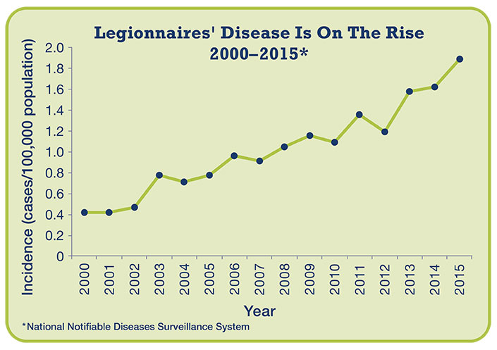
General Epidemiology

Slide 8
General Epidemiology
Why the increase in incidence?
More testing
Better surveillance
Aging population
Aging infrastructure
Warmer temperatures

Slide 9
North Dakota Epidemiology
Cases with a laboratory diagnosis are reportable to the North Dakota Department of Health.
ND Legionellosis Cases by Year
Year | 2006 | 2007 | 2008 | 2009 | 2010 | 2011 | 2012 | 2013 | 2014 | 2015 | 2016
Cases | 1 | 2 | 3 | 2 | 6 | 3 | 3 | 3 | 4 | 5 | 5

Slide 10
North Dakota Case Investigation
All cases are investigated by NDDoH field epidemiologists
Travel info
Possible water exposures
Possible healthcare exposures
Clinical data
EH personnel are alerted if possible exposure location identified
Because of the potential for outbreaks, including outbreaks in other states, Legionellosis is considered first priority, meaning case investigation is initiated within 24 hours.
Data are sent within five days to the Centers for Disease Control and Prevention.

Slide 11
Travel-Associated Cases
The NDDoH receives a notification if an out-of-state (or out-of-country) case traveled to North Dakota during their incubation period.
NOT included in North Dakota case count
Notification includes:
Limited non-identifiable demographic data
Location of stay
Dates of stay
Investigation prompted when more than one notification is received for a North Dakota building

Slide 12
Legionella and the Built Environment
Fresh water is reservoir for Legionella
In nature, Legionella generally exists in insufficient quantities to cause disease
Buildings can provide a more ideal environment for Legionella
Better environment for to growth
Opportunities for contaminated water to be aerosolized

Slide 13
Legionella and the Built Environment
How do Legionella (and other pathogens) get into a building’s water system?
What factors promote growth of Legionella once inside a water system?
Certain activities can introduce dirt and other materials into the system:
Construction (new and renovation)
Water main breaks
Changes to municipal water quality
These activities can help by either introducing Legionella or by introducing other materials that can use up available disinfectant.
The presence of biofilm, scale, and sediment
Fluctuations in water temperature and/or pH
Inadequate levels of disinfectant
Changes in water pressure
Water stagnation

Slide 14
Legionella and the Built Environment
Where can Legionella grow, spread, and aerosolize? Many places!
Hot and cold water storage tanks
Water heaters
Expansion tanks
Water filters
Electronic and manual faucets
Aerators
Faucet flow restrictors
Showerheads and hoses
Pipes, valves, and fittings
Centrally installed misters, atomizers, air washers, and humidifiers
Nonstream aerosol-generating humidifiers
Infrequently used equipment including eyewash stations
Ice machines
Hot tubs
Decorative Fountains
Cooling towers
Medical equipment
CPAP machines
Hydrotherapy equipment
Bronchoscopes

Slide 15
Water Temperatures
Temperature ºC/ºF |  | State of Legionella
<20 | <68 | Dormant but viable
35-46 | 95-115 | Optimal growth
50 | 122 | 90% Kill in two hours
60 | 140 | 90% Kill in two minutes
>70 | >158 | 100% Rapid kill

Slide 16
Biofilms
Building water systems offer a warm, enclosed space with regular access to air and water—great for Legionella and other aerobic organisms!
Biofilms can be difficult to remove
How a single Legionella bacterium can contaminate your water system:
attaches to biofilm →
replicates to form a microcolony →
colony matures →
bacteria break of colony to form new colonies on biofilm →
some bacteria break of colony and continue in water system to end fixture

Slide 17
Outbreak Investigation
When the NDDoH discovers a building is a shared risk factor for two or more unrelated cases of Legionellosis, and outbreak investigation is prompted
A full investigation will include personnel from Disease Control, the Division of Microbiology, and local environmental health personnel
Notes:
Facilities may also request assistance when it is known that a single case of Legionellosis has been identified in a facility.

Slide 18
Outbreak Investigation
Additional case information obtained, including information about accommodations, and visits to surrounding attractions
An environmental assessment is conducted at the facility
Samples as collected from various locations with in the facility for laboratory testing

Slide 19
Environmental Assessment
Following an outbreak, the investigation team will view the facility and speak with building maintenance personnel; investigations include:
Review of building water system, including building schematics, water management plants, sample results, and recent consultancies
Tour of all buildings on the premises
Sample collection from
The NDDoH utilizes the CDC outbreak toolkit for outbreak investigation, which provides a comprehensive form for guiding the environmental investigation (see Resources slide)

Slide 20
Environmental Assessment: Sample Collection
During sample collection, the following is measured or obtained:
Chlorine residual levels
Water temperature
pH
Water Sample
Biofilm samples (swab)
It is important to make sure the right equipment and sufficient supplies are on hand to conduct an environmental assessment

Slide 21
Environmental Assessment: Sample Collection
Important equipment for samples collection can include:
Sterile plastic 1 L bottles (at least one for every location that must be sampled)
Sodium Thiosulfate
Pipettes and bulbs
Chlorine analyzer
Thermometer
Labels
Chain of custody documentation
Dacron-tipped swabs
Sterile plastic screw top tubes
Coolers or other equipment needed for transport

Slide 22
Environmental Assessment: Sample Collection
Common locations where samples are collected can include:
Sinks and showers
Pools and hot tubs (including filters)
Hot water heaters
Water softening equipment
Municipal point of entry
Medical equipment that utilizes and holds water
Decorative water features
Any kind of water storage tank or device that is part of the water system
The CDC provides excellent training videos on how to collect and transport samples. These techniques can be used for both outbreak and routine sample collection (see Resources slide)

Slide 23
After an Environmental Assessment
Collected samples will be analyzed for the presence of Legionella (results can take 10-14 days)
The outbreak team with work with the CDC to create recommendations for remediation or future action
Results and recommendations are provided to the facility
Recommendations will be provided in writing; information for immediate action will also be provided verbally
Failure to isolate Legionella in collected samples is does not indicate the facility is free from Legionella

Slide 24
After an Environmental Assessment: Remediation
ASHRAE recommends two methods to remove Legionella:
Hot water flush (160-170ºF)
System chlorination (min 2 ppm, 2 hours)
Remember: Legionella identified at one point can could have come from anywhere upstream in the water system!
Follow-up testing and system monitoring will occur after remediation
May choose to engage a Legionella consultant
Notes:
On consultants—facility choice, may want to hire someone like an industrial hygienist to help with changes moving forward

Slide 25
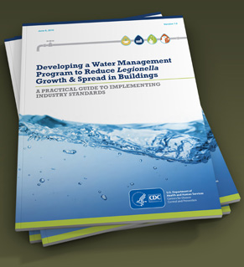
Avoiding Outbreak through Water Management
Ongoing control is important in reducing the burden of Legionellosis
ASHRAE Proposed New Standard 188: Prevention of Legionellosis Associated with Building Water Systems
In response, the CDC has developed a toolkit to help building owners:
Evaluate their water system
Develop a water management plan if one is needed
Notes:
See resources section for link to water management plan

Slide 26
New CMS Rule
New regulation to reduce Legionella (and other waterborne pathogen) risk in:
Hospitals
Skilled nursing facilities and nursing facilities
Critical access hospitals
A response to outbreaks identified in hospitals and nursing homes
High-risk populations
Large, complex water systems
Requires facilities to create and follow a water management plan

Slide 27
What About Routine Testing?
Question: Is routine testing for Legionella recommended?
Answer: Sometimes!
Why test for the presence of Legionella?
Following an outbreak or identified facility related case—Yes!
Validation of efficacy of water management program—Maybe! (or, perform surveillance for Legionella infections)
Regular monitoring of water quality parameters (i.e. disinfectant levels, temperature) is recommended as part of a water management program
Notes:
Additional information from CMS may be forthcoming, but likely will not provide explicit instructions on exactly what/when to test

Slide 28
Validation Testing
Specific decisions about sample frequency, location, and methodology should be made by the building’s water management team as part of a comprehensive water management program
Sampling plans should be based on a variety of factors including:
Environmental assessments and baseline Legionella data
Performance of water management program and trend analysis of Legionella test and water quality parameter results
Correlation of environmental testing results with clinical surveillance data
Building characteristics (age, complexity, populations served)
Sites of possible exposure to aerosolized water
Available resources to support testing.

Slide 29
Where can Validation Samples be Sent?
A private lab
In the future, the NDDoH Division of Microbiology
Will be fee-for-service
An announcement will be made when this is available

Slide 30
Thank you! Jill Baber NDDoH Epidemiologist 701-328-3341 jbaber@nd.gov
Questions?

Slide 31
Resources
CDC Legionella toolkit: https://www.cdc.gov/legionella/downloads/toolkit.pdf
CDC Legionella Environmental Assessment Form: https://www.cdc.gov/legionella/downloads/legionella-environmental-assessment.pdf
CDC environmental investigation videos: https://www.cdc.gov/legionella/videos.html
CMS Legionella and Other Waterborne Pathogens Surveyor Training Video: https://surveyortraining.cms.hhs.gov/pubs/VideoInformation.aspx?id=134&cid=0CMSLEGWEB-Archived

